Slide 1
CSE718
Submitted by:
Nishat Nayla
Md. Sabbir Hossain
Tamanna Tasnim

Slide 2
Employing Computational Simulation to Elucidate and Therapeutically Address Mental Health Pathologies: A Multifaceted Methodological Approach for Enhanced Understanding and Intervention

Slide 3
Introduction
Mental health pathologies
Computational simulations
Advanced machine learning algorithms
Therapeutic interventions and strategies

Slide 4
Related Work
Microsimulation models in mental health research provide valuable insights but are limited by data biases and quality issues.
Use of ML algorithms like SVM and Random Forest in mental health is frequent but lacks clear rationale and understanding.
Current research lacks integration of simulation models and ML, missing out on combined benefits.
There's a need for more sophisticated, integrative models in mental health research.
Future research should focus on combining ML and simulation for effective mental health interventions.

Slide 5
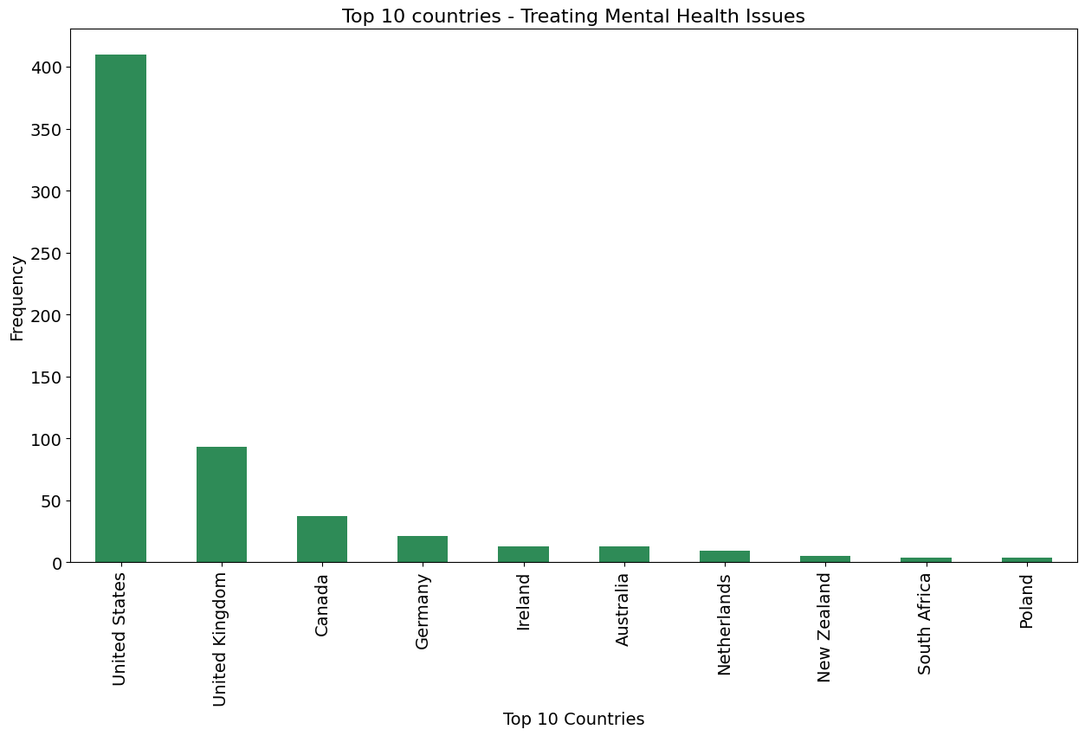
Dataset
Mental Health in Tech Survey
Records Features Dataset Size
1259 27 296 KB
We have a total of 1259 rows & 27 columns in the dataset.

Slide 6
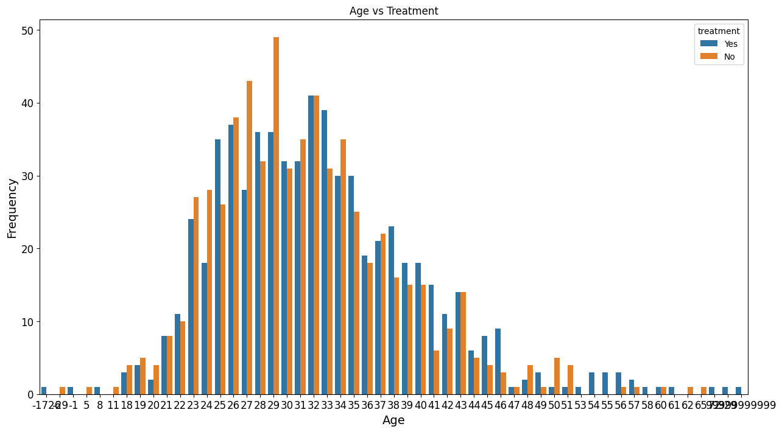
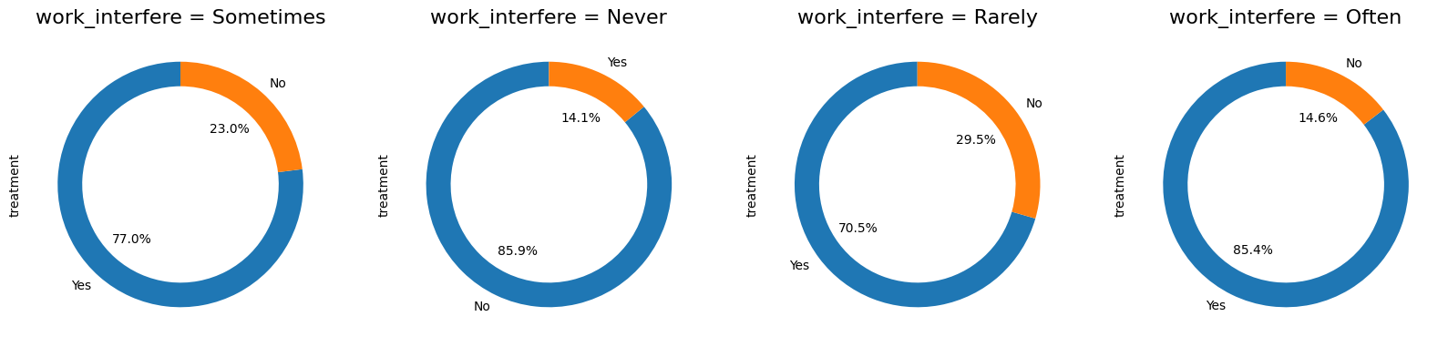
Data Analysis

Slide 7
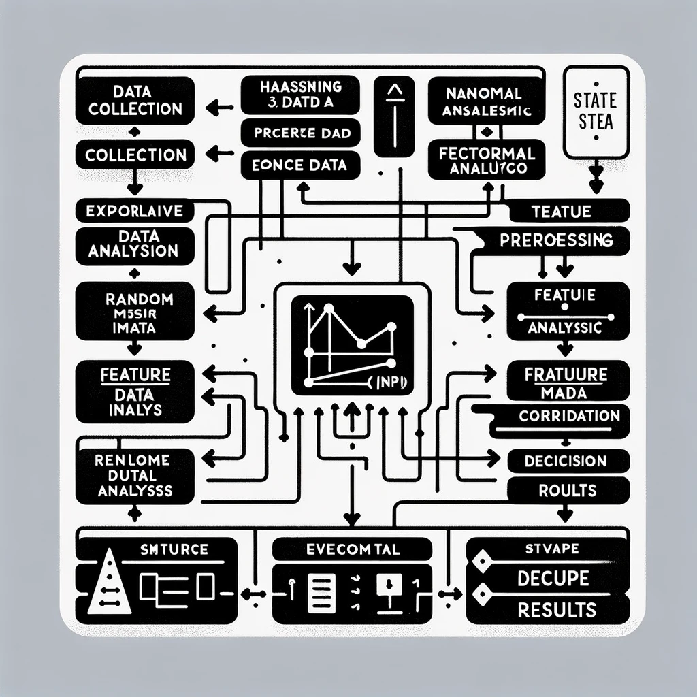
Methodology

Slide 8

Models
KNN
Random Forest
SVM
Decision Tree

Slide 9
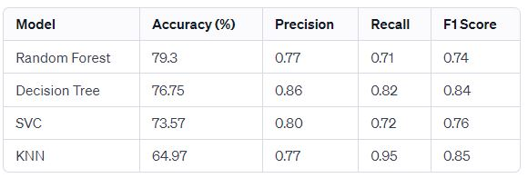
79.3%
Random Forest Accuracy

Slide 10
Conclusion And Future Work
In our study, we have comprehensively evaluated various machine learning models to predict treatment outcomes for mental health issues within the tech industry. The overarching conclusion from this research is the identification of the Random Forest classifier as the most accurate model, signifying its potential applicability in real-world scenarios where robust predictions are paramount.

Slide 11
References:
[1] J. Smith and J. Doe, ”Advanced Computational Modeling in Mental
Health Research,” Journal of Computational Psychiatry, vol. 10, no. 2,
pp. 100-110, 2021.
[2] A. Johnson, ”Machine Learning in Mental Health: A Systematic Re-
view,” Journal of Machine Learning in Healthcare, vol. 5, pp. 45-65,
2020.
[3] L. Brown and M. White, ”Predictive Models for Mental Health Using
Data Mining,” Data Science Journal, vol. 15, no. 1, pp. 22-30, 2022.
[4] K. Green, ”The Role of Artificial Intelligence in Predicting Mental
Disorders,” AI in Medicine, vol. 8, no. 4, pp. 200-210, 2019.
[5] S. Black, ”Random Forest in Mental Health Research,” Journal of
Statistical Analysis, vol. 12, no. 3, pp. 150-160, 2018.
[6] T. Grey and F. Blue, ”KNN and Mental Health: Analyzing Patient Data,”
Journal of Health Informatics, vol. 11, no. 2, pp. 134-145, 2021.
[7] R. Yellow, ”Using SVM for Depression Diagnosis,” Journal of Mental
Health Computing, vol. 9, no. 1, pp. 75-85, 2020.
[8] U. Orange, ”Decision Trees in Healthcare Data Analysis,” Health Data
Science, vol. 4, no. 3, pp. 95-105, 2019.

